Slide 1

G H Raisoni College of Engineering, Nagpur
Department of Information Technology
Project Seminar-II
(Session: 2023-2024)
Title of the Project:-“IPL Match Prediction
Using Machine Learning”
Presented By:
Shivam Narad (A-62)
Shrawil sarve (A-63)
Chetan Kumbhare (b-49)
Himanshu Dongare (b-59)
Guide:-
Prof. Ritu Pawar
GHRCE ,Nagpur

Slide 2
Introduction
The Indian Premier League (IPL) is one of the most popular and competitive T20 cricket leagues in the world. Predicting the outcome of IPL matches is not only a matter of interest but can also have significant financial implications for various stakeholders
Machine learning models can be trained on past IPL data to identify patterns and trends, ultimately helping to forecast which team is more likely to emerge victorious in a given season
This project aims to use machine learning techniques to predict IPL match results accurately, enhancing the excitement for cricket enthusiasts.
The forecasting of sports prediction has not only used as entertainment, but also helps for gameplay assessment of players, teams, leagues, and thus the associated results.

Slide 3
Objective
The objective of this project is to develop an efficient system for predicting the outcome of IPL cricket match. Several factors, both in-game and pre-game, such as the venue, past team performance, and Current run rate and overs completed, play a significant role in determining the result of a match.
This project also places a strong emphasis on conducting in-depth exploratory data analysis, building predictive models, and creating data visualizations related to the Indian Premier League (IPL). To achieve the best possible match outcome prediction, we used Random Forest Classifier and Logistic regression classifier.
Additionally, to ensure convenient access and usability of the predictions, the project intends to deploy a user-friendly web application that is compatible with various web browsers.

Slide 4
Hardware /Software Specification
Hardware:
GPU would be better
Processor: Intel Core i3 or above
Ram: 4 GB Minimum
Disk Space: 2 GB Minimum
Software:
Python 3 or above (packages like numpy, matplotlib, seaborn, pandas and sklearn)
For Web Application Streamlit app framework
Operating System: Windows 7 or above

Slide 5
Literature Survey
Daniel Mago Vistro, Faizan Rasheed, Leo Gertrude David [1] the target of this research was to predict the match winner of IPL using historical data of IPL from season 2008 to 2017. SEMMA methodology has been selected for conducting the analysis of IPL T20 match winner dataset. Preprocessing has been done on the dataset to form it consistent by removing missing value, encoding variables into numerical format. Best features were selected by visualizing attributes of knowledge with target variable. On selected features several machine learning models has been applied on the to predict the winner and therefore the results were outstanding. Decision Tree model was applied which predicted the match winner with good accuracy 76.9%.
Rabindra Lamsal & Ayesha Choudhary [2] It includes the varied factors that influence the result of an Indian Premier League matches were identified. The seven factors which significantly influence the results of an IPL match include the house team, the away team, the toss winner, toss decision, the stadium, and therefore the respective teams’ weight. Hence designing machine learning model for predicting the match outcome of an auction based 2020 format premier league with the accuracy of 72.66% & F1 score of 0.72 is very satisfactory at this stage.

Slide 6
Literature Survey
Rameshwari Lokhande [3] The problem of churning is addressed by using interactive models of Predictions where a user predicts the results of each game in order to be rewarded which would further help him strengthen his Fantasy squad. The project thus, aims not only to attract more users to this game that is Fantasy Cricket, but also aims at improving the general attraction to the Premier League. This happens because in a predictive model, a user makes a prediction on every game, and ends up watching that game to check if his prediction is going right.
Siddharth Sinha [4] This model is employed for predicting the result of the match supported historic data. During the extraction of features various features has been involved but most vital features has been taken during prediction. They also made a team structure in terms of slots which defines most vital slots contributing to match winning and a ranking system for the players through their performance statistics. They used K-means to cluster all players consistent with their performance and KNN (K-nearest neighbor) is employed to seek out interchangeable player to a specific player. SVM model was trained using linear, polynomial and RBF (Radial Basis function). Thus, they preferred SVM with RBF kernel for prediction.

Slide 7
Proposed Model
PROPOSED APPROACH
The project will involve the implementation of classifiers that includes data preprocessing techniques such as one-hot encoding for categorical features and feature selection.
Random Forest will be employed for the initial model development, and Logistic Regression will be used as an alternate classifier for comparison.
The goal is to leverage historical IPL match data to build a predictive model that can assist cricket enthusiasts and betting enthusiasts in making informed decisions regarding match outcomes.
Finally, we used Streamlit Open Source Framework for frontend for the model generated. So that a person can select dropdown in the web application and receive a prediction of win percentage of the team.

Slide 8
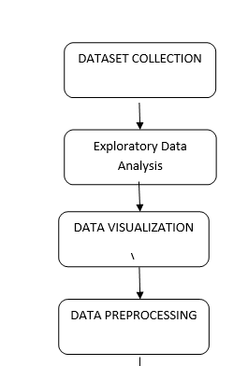
Proposed Model

Slide 9
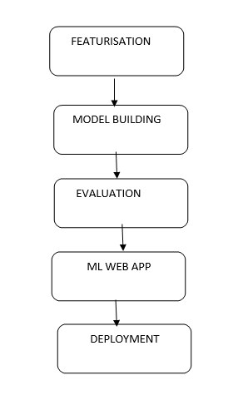
Proposed Model

Slide 10
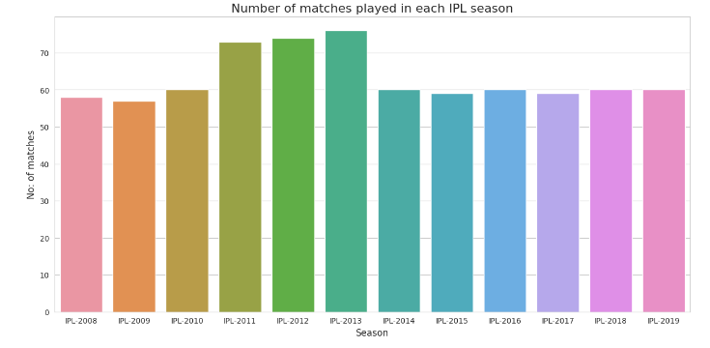
EXPLORATORY DATA ANALYSIS SOME PLOTS
Most number of matches were played in IPL-2013 Season

Slide 11
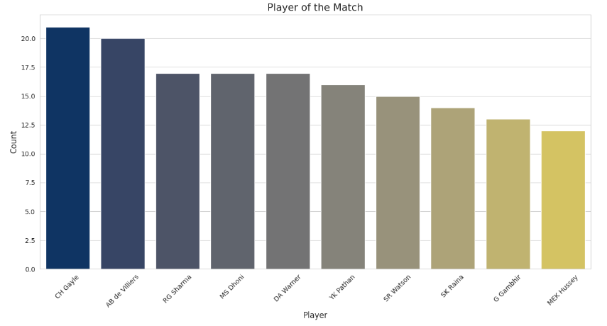
EXPLORATORY DATA ANALYSIS SOME PLOTS
Most Man of the Match Titles Won Player

Slide 12
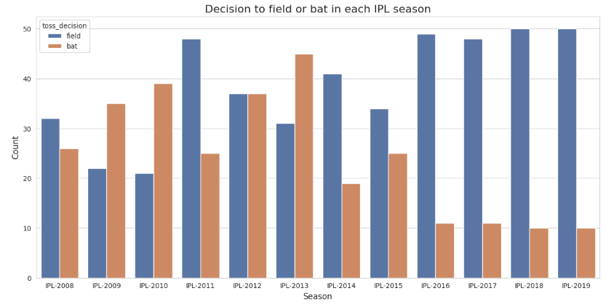
EXPLORATORY DATA ANALYSIS SOME PLOTS
We can see a trend that, decisions to field are more from IPL-2016 Season

Slide 13
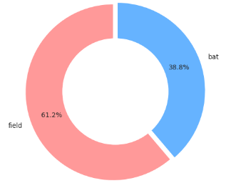
EXPLORATORY DATA ANALYSIS SOME PLOTS
In more than 61% of matches, teams chose to field after winning the toss

Slide 14
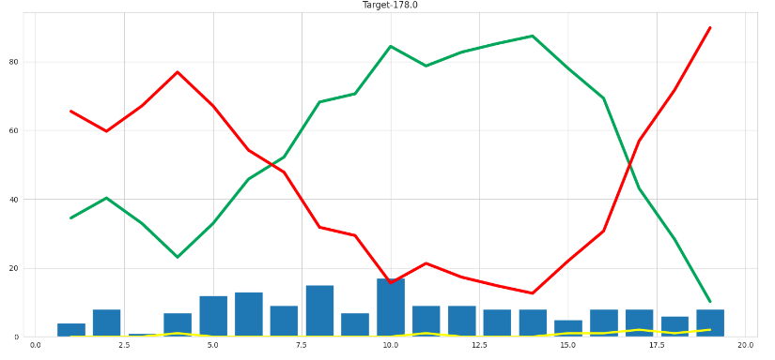
EXPLORATORY DATA ANALYSIS SOME PLOTS
A graph to visualize the match's progress, including wickets, win probability, and lose probability.

Slide 15
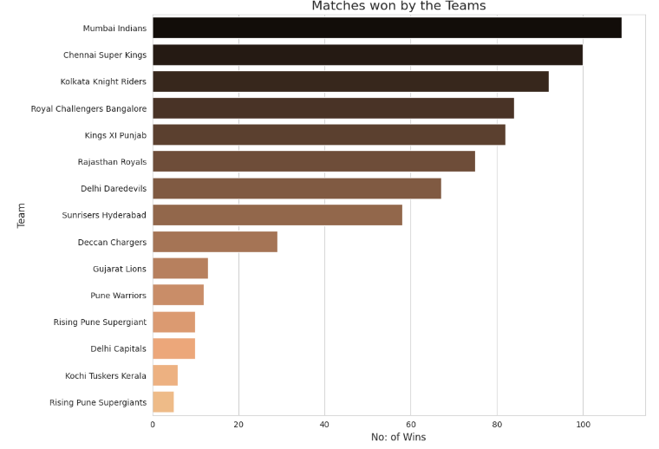
EXPLORATORY DATA ANALYSIS SOME PLOTS
Mumbai Indians won most number of matches followed by Chennai Super Kings

Slide 16
Proposed Model
Data Loading
Data loading in machine learning is the process of bringing external data into a machine learning environment or program for analysis and model training.
Imported the necessary libraries numpy and pandas used for data cleaning and analysing the data.
It loads two CSV files, 'matches.csv' and 'deliveries.csv', into Pandas DataFrames named match and delivery.
2) EDA Data Visualization
Data visualization is the graphical representation of data to gain insights, patterns, and trends, facilitating a better understanding of the underlying information for improved decision-making and model development.

Slide 17
Proposed Model
3) Data Preprocessing
Data preprocessing is the technique of cleaning, transforming, and organizing raw data into a structured format suitable for analysis, which is essential for enhancing the performance and accuracy of machine learning models.
Important features are extracted and a final_df contains total of 10 selected features from matches_df and deliveries_df .
Some team names are standardised to ensure consistency. For example,we replaced 'Delhi Daredevils' with 'Delhi Capitals' and 'Deccan Chargers' with 'Sunrisers Hyderabad’.
Also filtered matches based on certain conditions, like eliminating matches with the Duckworth-Lewis method applied (dl_applied == 0) and retaining matches involving specific teams in the teams list.

Slide 18
Proposed Model
4 )Model Building
Splitting Data for Machine Learning
It splits the data into features (X) and the target variable (y).
Imported additional libraries for machine learning: ColumnTransformer, OneHotEncoder, LogisticRegression, RandomForestClassifier, and Pipeline.
5 )Model Training and Evaluation
It fits the pipeline on the training data (X_train, y_train) and makes predictions on the test data (X_test).
It calculates the accuracy of the model using accuracy_score.

Slide 19
Proposed Model
6) Model Serialization
It imports pickle to serialize (save) the trained model pipeline as 'pipe.pkl’ which is further used for our rontend ipl match prediction.

Slide 20




Work Division
Work Division
Chetan Kumbhare
Shivam
Narad
Handled the data visualization part
Handled the documentation
Himanshu
Dongre
Shrawil
Sarve
Decided which ML Models to use.
Analyzed the accuracies of the models.
Helped in implementing the ML Model
Also made use of machine learning pipeline.
Handled the documentation
Also handled the eda scatterplots

Slide 21
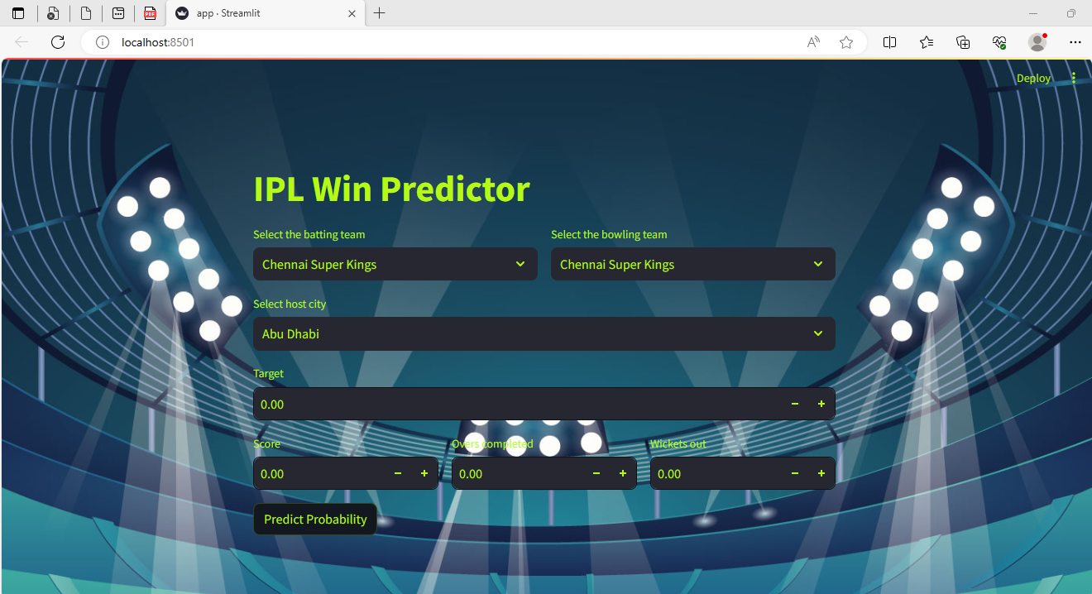
Frontend

Slide 22
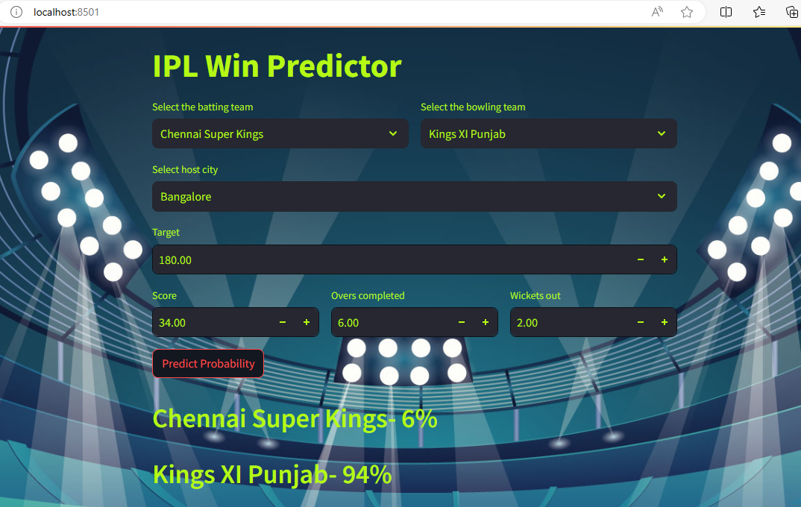
OUTPUT:

Slide 23
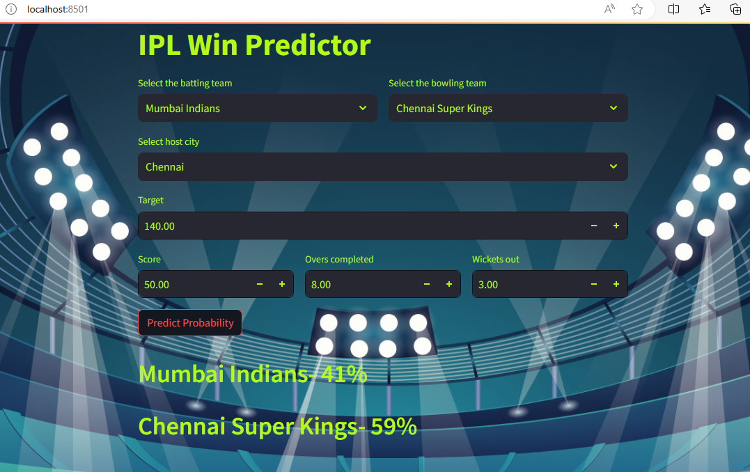
OUTPUT:

Slide 24
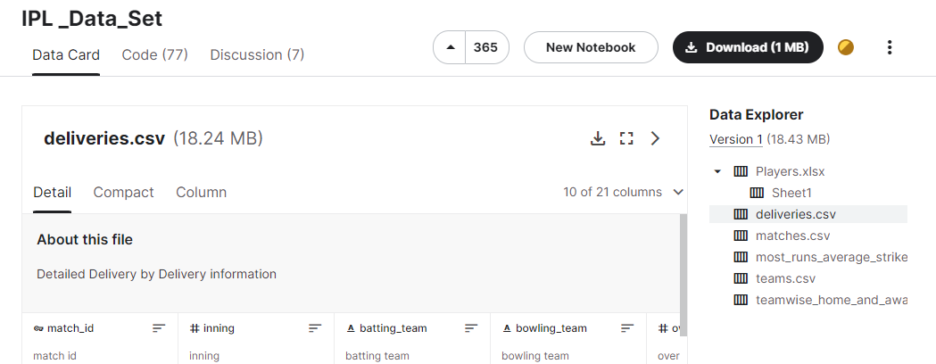
Data Collection
Data set has been collected from Kaggle.com
(https://www.kaggle.com/datasets/ramjidoolla/ipl-data-set)
In our project, we have used 2 dataset csv files – deliveries.csv and Matches.csv

Slide 25
Conclusion
Various factors have been identified that contribute to the results of the Indian Premier League matches. Factors that have a major impact on the outcome of an IPL match include the teams playing, the venue, the city, the current score, current run rate, required Run rate and runs.
.
The best algorithm for prediction is the Random Forest, which has a pinpoint prediction accuracy [on “IPL dataset taken from Kaggle.com"].
As a result, combining our Random Forest and the attributes of this dataset, ipl match result may be predicted with near-perfect accuracy.
Hence Web application is using Random Forest algorithm model via Pickle file for prediction on Website.

Slide 26
Reference
Daniel Mago Vistro, Faizan Rasheed, Leo Gertrude David “Cricket winner prediction with application of machine learning and data analytics” IJSTR Volume 8, Issue 09, September 2019.
Rabindra Lamsal and Ayesha Choudhary “Predicting Outcome of Indian Premier League (IPL) Matches Using Machine Learning” ResearchGate (2020)
Rameshwari Lokhande “Prediction of live cricket score and winning” IJRTD Volume 5(4), (2018).
Siddharth Sinha “IPL Win Prediction System To Improve Team Performance using SVM” IJFGCN Vol. 13, (2020)
Sanjay Gupta, Hitesh Jain, Asmit Gupta and Hemant Soni, “Fantasy League Team Prediction”, International Journal of Research in Science and Engineering, Vol. 6, No. 3, pp. 97- 103, 2017.

Slide 27
Reference
6) 13) Pabitra Kumar Dey, Gangotri Chakraborty, Purnendu Ruj and Suvobrata Sarkar, “A Data Mining Approach on Cluster Analysis of IPL”, International Journal of Machine Learning and Computing, Vol. 2, No. 4, pp. 351-354, 2012.
7) Raza Ul Mustafa, M. Saqib Nawaz, M. Ikram Ullah Lali, Tehseen Zia and Waqar Mehmood, “Predicting the Cricket Match outcome using Crowd Opinions on Social Networks: A Comparative Study of Machine Learning Methods”, Malaysian Journal of Computer Science, Vol. 30, No. 1, pp. 63-76, 2017.
8) Jayshree Hajgude, Aishwarya Parameshwaran, Krishna Nambi, Anupama Sakhalkar and Darshil Sanghvi, “IPL Dream TeamA Prediction Software Based on Data Mining and Statistical Analysis”, International Journal of Computer Engineering and Applications, Vol. 9, No. 4, pp. 113-119, 2015.

Slide 28
Thank You…..

